Slide 1


ALC / CTI

Slide 2


ALC
Great Facility
  Quiet
  Easier to Control student movements
  Secure/Safe
  Feels like a school
Great Partners
    SMSU
    SWWC

Slide 3
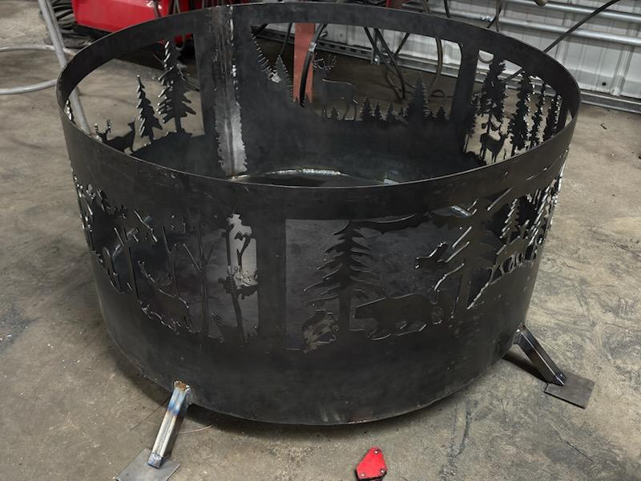

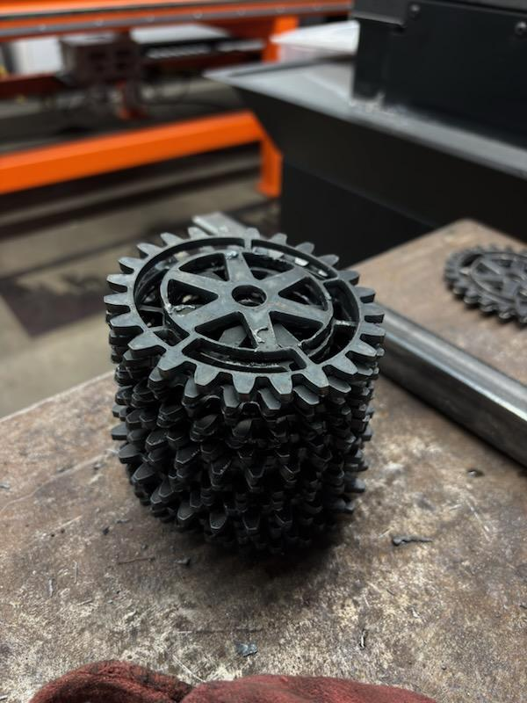
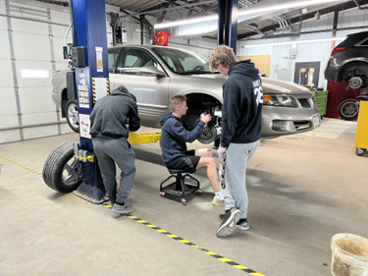
CTI
Classes going well
  Manufacturing
    Projects
    CNC Plasma Table
    CNC Mill
    Future Plans
  Autos
    Projects
    Future Plans
  CNA
    16 Hours of Field Experience
    Future Plans

Slide 4
Future of the CTI
Expanding the Trades
  Programs
  Construction
  Robotics/Automation
More Engagement
  Communities and Industries
  SMSU and MNWest

Slide 5
Questions?

